Slide 1


Integrated contents recommendation
platform using Multi-Modality
Team: 5G

Slide 2


Part 1
service
ⓒSaebyeol Yu. Saebyeol’s PowerPoint

Slide 3
Part 3
Weakness
OTT already has these functions.
There is no competitivity.
Students cannot develop recommender system which has different
characteristics

Slide 4
Part 3
Then what to do? Cross Domain!
Addressing cold start problem -> cross selling of products
Improving accuracy by reducing sparsity

Slide 5
Part 3
Solution: CDR
Cross Domain Recommendation
Not domain independently
,
Source
Domain
Target
Domain
"Recommendation"

Slide 6
Part 3
Solution1: CDR
Movie
Book
Drama
Music
Webtoon
Travel

Slide 7
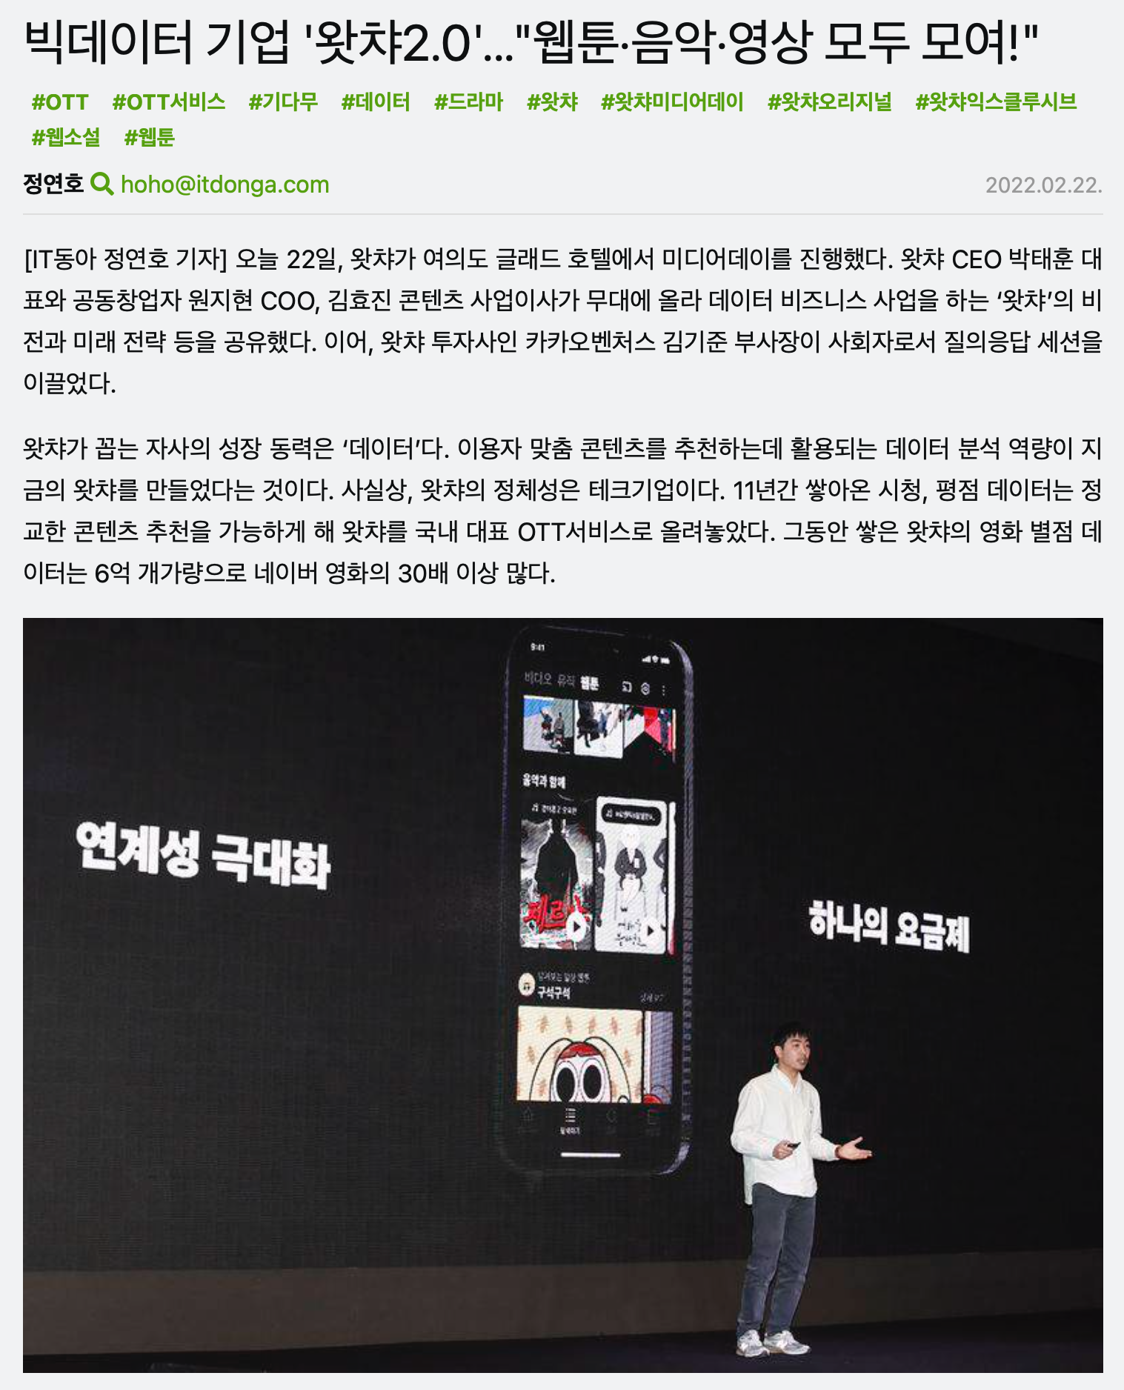
Part 3
Services that implement(item to item) CDR are relatively
new on the market
Watcha launched webtoon services recently on October 2022.
Notes:
As we searched on pre-existing services, we in fact found some OTT services are starting to implement item to item CDR systems in their services. For instance, Watch launched webtoon services recently in October 2022(last year) that has a potential to use CDR systems that merge movies, dramas, webtoon data to offer a better recommendation. This is a relatively new tech on the market.

Slide 8
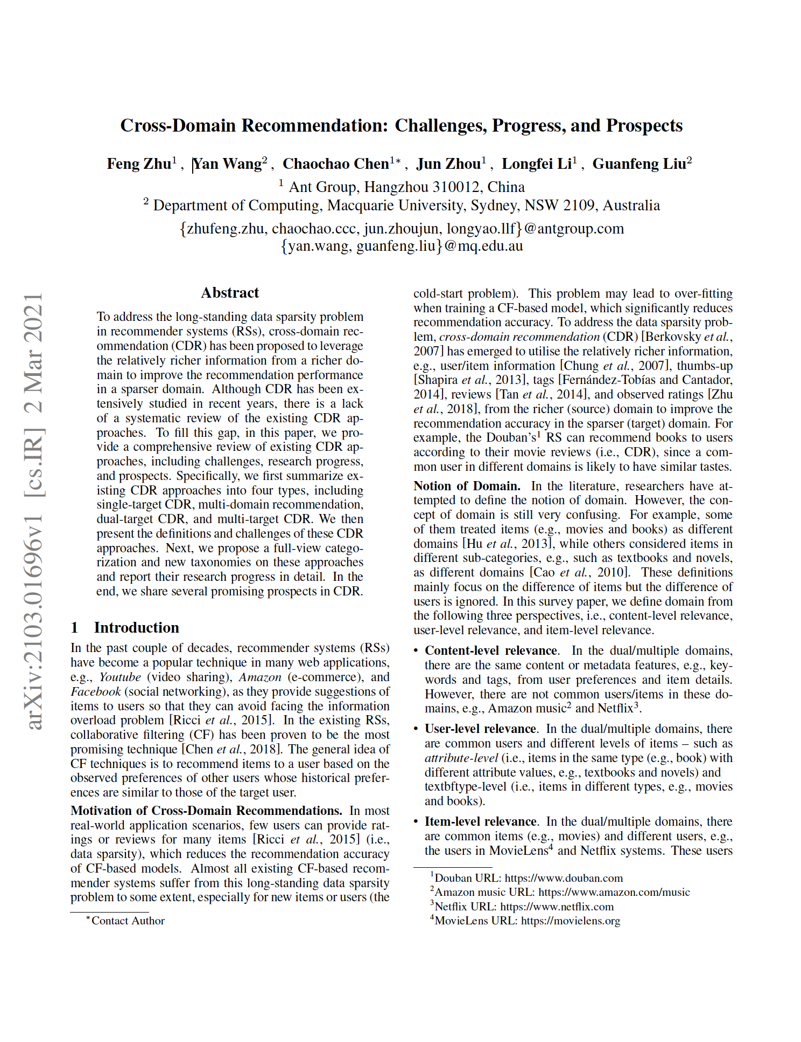
Part 3
CDR research is still ongoing..
“to improve the recommendation accuracy in the target domain ··· Therefore, how to build a suitable content-based relation in single-target CDR (content- level relevance) scenario is very important and challenging.”
Notes:
However, even though some very few OTT services are starting to implement CDR systems to their services, this topic is a relatively new concept and the research is still ongoing. We brought a 2021 paper called “Cross-Domain Recommendation: Challenges, Progress, and Prospects” that reviews overall progress and existing limitations regarding CDR research. To give you some example, In case of Single-Target CDR, it says that “to improve the recommendation accuracy in the target domain, one should first build content-based relations, then choose similar users/items according to their common features, and finally, transfer/share other features between similar users/items across domains. Therefore, how to build a suitable content-based relation in single-target CDR (content- level relevance) scenario is very important and challenging.” This is something we can think about and work on our project.
So the point we want to finally make is that, even though existing state-of-art OTT recommendation systems may have excelling performances due to their large data asset, it is still meaningful to work on this relatively new topic(CDR systems) because there are lot of spaces we can work on to overcome limitations and improve accuracy.

Slide 9


Part 2
Model
ⓒSaebyeol Yu. Saebyeol’s PowerPoint

Slide 10
Part 2
Contents based Model architecture
Drama Title
Title Embedding
Drama Genre
Genre Embedding
Pretrained Model
koBERT
Webtoon Title
Title Embedding
Webtoon Genre
Genre Embedding
Movie Title
Title Embedding
Movie Genre
Genre Embedding

Slide 11







Part 2
Contents based Model architecture
Calculate the relevance of embedding

Slide 12
Part 2
CF Model architecture
target
target
target
BPR Loss
User1
drama encoder
webtoon encoder
movie encoder
Drama1
Webtoon1
Movie1

Slide 13
Part 2
Encoder design
Experiment1
Parameter sharing
drama encoder
webtoon encoder
Movie encoder
Experiment2
Use independent parameters
drama encoder
webtoon encoder
movie encoder

Slide 14
Part 2
Encoder design
Ensemble method
itemKnn, userKnn, NeuMF, BPR, Simplex, Biser, EASE, LightGCN, multVAE, FM
aggregation
Voting, weighted sum
model1
model2
model3
model4
제목을 입력하세요
Drama1

Slide 15

Part 3
Data
ⓒSaebyeol Yu. Saebyeol’s PowerPoint

Slide 16



Part 1
Data
Content-based
Movie
Drama
Webtoon
Naver Movie dataset
IMDB
IMDB
Korea webtoon dataset
Title
Genre
Director
Plot summary
...
Title
Genre
Author
Description
...
Title
Genre
Country
Director
Description
...
Notes:
모델을 학습하기 위해 필요한 데이터셋입니다. 콘텐츠 기반 학습의 경우 내용의 유사도를 기반으로 합니다.
영화의 경우 네이버 영화와 IMDB에서 데이터를 크롤링할 수 있고, 드라마 역시 IMDB에서 제목과 내용 데이터를 가져올 수 있습니다.
IMDB에 드라마, 영화 데이터가 모두 있고 plot summary도 나와 있어서 크롤링 하면 영화와 드라마 데이터셋으로 모두 활용할 수 있을 것 같습니다.
웹툰의 경우 kaggle에 있는 korean webtoon dataset을 활용할 수 있습니다.
(+왓챠피디아는 줄거리 설명이 상세하지 않아서 사용하기 어려울 것 같습니다.)

Slide 17

Part 1
Dataset
User data
MovieLens dataset (2019)
25,000,095 ratings across 62,423 movies
Created between 1995-2019
All selected user had rated 20+ movies
Notes:
User dataset으로 활용할 수 있는 movielens 데이터입니다.
1995년부터 2019년까지 수집된 데이터이며, 최소 20개의 리뷰를 남긴 사용자들의 정보가 담겨 있습니다.
데이터셋 출처: MovieLens | GroupLens

Slide 18
Part 1
Dataset
User data
Amazon review data (2018)
Movies and TV : 8,765,568 reviews
5-core : 3,410,019 reviews
Data format
Reviewer ID
Product ID
Rating
...
Notes:
서로 다른 도메인에 대한 추천이 이루어져야 하기 때문에 이에 대한 사용자 데이터셋이 필요합니다.
Amazon review dataset-아마존에 올라온 리뷰들을 모은 데이터셋입니다. Movies and TV 카테고리에 약 8백만개의 리뷰가 존재합니다.
그 중에 한 사용자 당 최소 5개의 리뷰를 남긴 데이터는 약 3백만개입니다.
이를 활용하여 user data를 확보할 뿐만 아니라, 만들어진 모델이 cross domain recommendation의 기능을 얼마나 잘 수행하는지 평가할 수 있습니다.
데이터셋 출처: Amazon review data (ucsd.edu)

Slide 19

Q&A
ⓒSaebyeol Yu. Saebyeol’s PowerPoint

